Slide 1
Modeling the Effects of Auditory Neuropathy on the Auditory Brainstem Response
Graham Voysey
Binaural Hearing Lab
BME GSC Student Seminar Series
31 March 2016

Slide 2

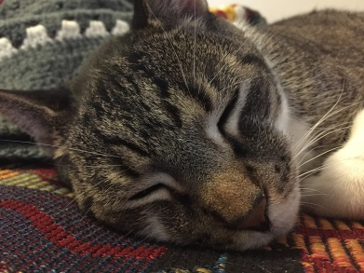
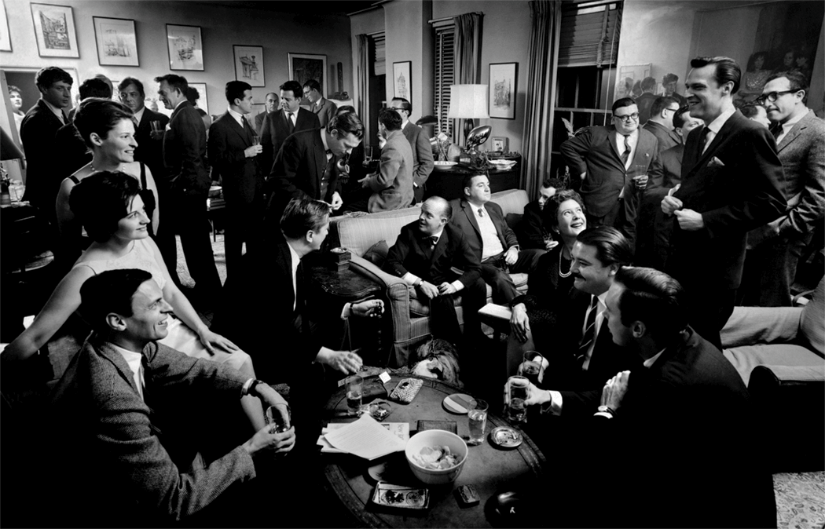
Motivation: Big Picture
Hidden Hearing Loss is not diagnosed by standard audiometric threshold testing
Audiometry tests for detection, not discrimination.
NHT performance differences
Mechanism(s) of HHL currently under debate;
No objective diagnostics for loss of discrimination currently exist

Slide 3
Probable Causes of HHL
Central Processing Disorder: A polite way of saying “We have no idea. Your ear seems fine; maybe it’s all in your head”
Sometimes, deficits or disorders actually are central (e.g., tinnitus)
Auditory Neuropathy (Cochlear Synaptopathy):
What would peripheral damage that does not affect thresholds or middle ear mechanics, but does affect the fidelity of the transmission of sound from the ear to higher areas look like?
And, where would it happen?
Auditory Nerve is a good place to start looking.

Slide 4
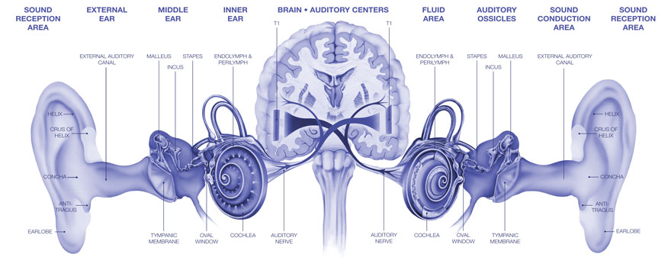
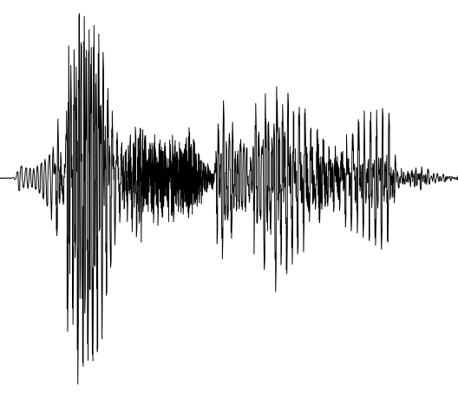
(Interlude) Mechanics of Hearing
http://entsa.net

Slide 5
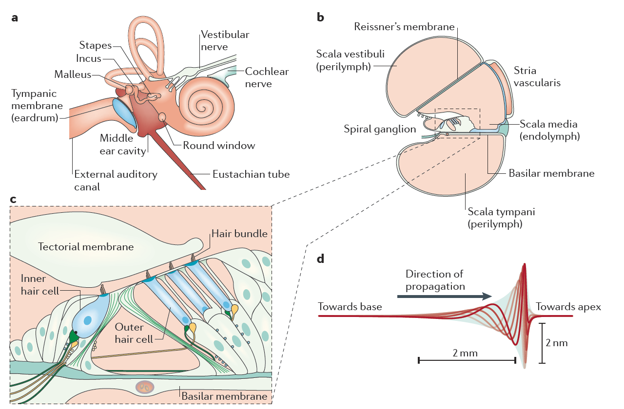
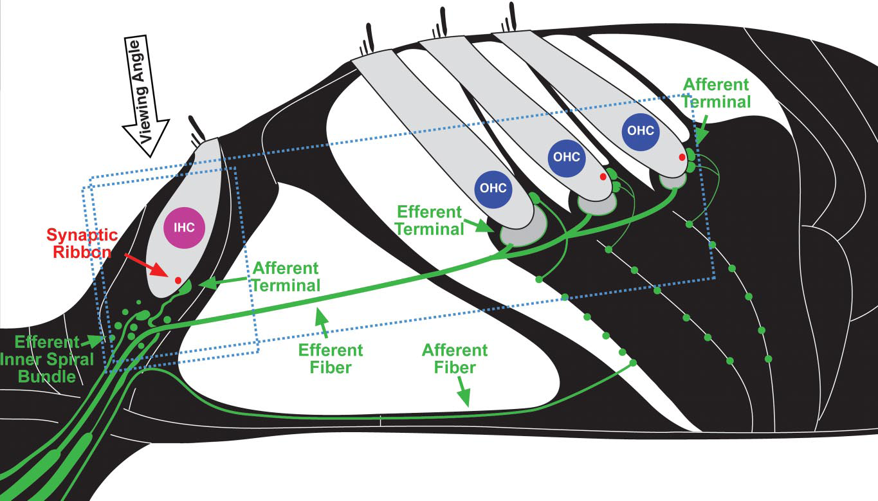
(Interlude) Mechanics of Hearing
Basilar Membrane motion → Spikes on AN fibers
Beginning of tonotopic organization
Many fibers per IHC
Fibers have two (or three) categories according to their spontaneous firing rate
Kujawa & Liberman (09), Hudspeth (14)
Hudspeth, 2014

Slide 6
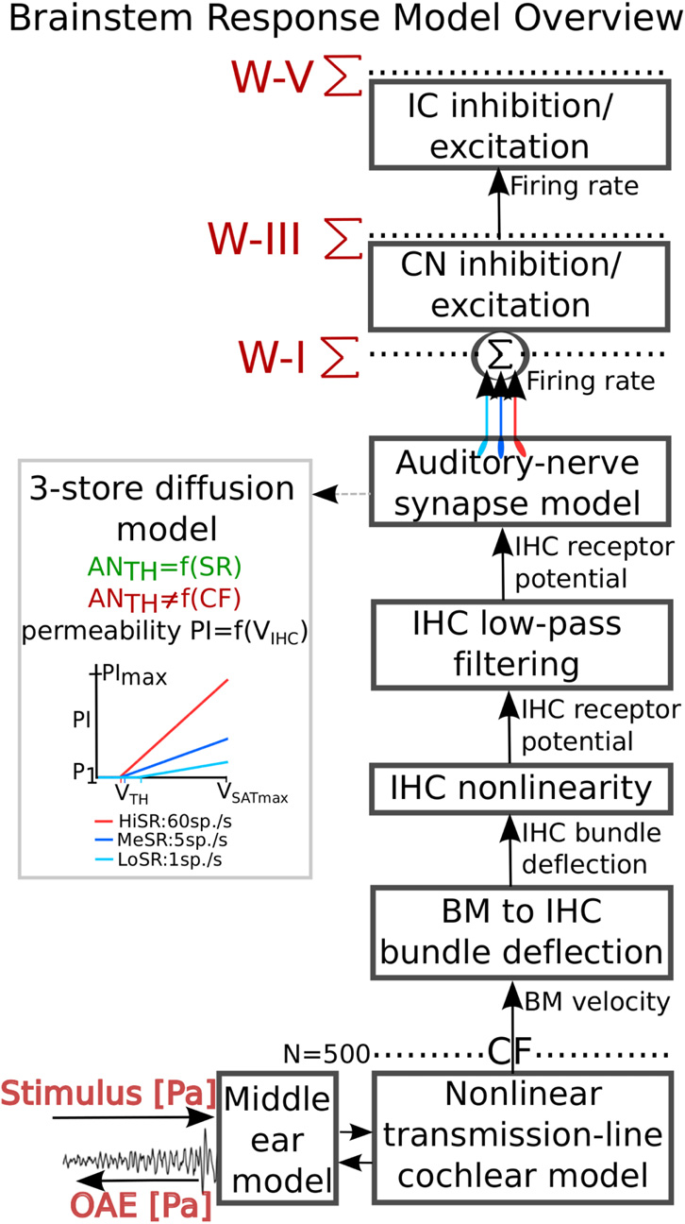
(Interlude) Models of Audition
Verhulst et. al (2012,14)
Transmission-Line (“Slinky”) model of cochlea → Basilar Membrane {x(t),v(t)}
BM v(t) → Inner Hair Cell spike probability
IHC → Auditory Nerve Instantaneous Firing Rate
Weight by fiber type, sum → AN response, ABR Wave I
Nelson and Carney (2004)
Cochlear Nucleus (Wave III), Inferior Colliculus (Wave V)
CN : conv(AN, inhib, excit, lag)
IC : conv(CN, inhib, excit, lag)
∑ (IC) → ABR
Verhulst (15)

Slide 7
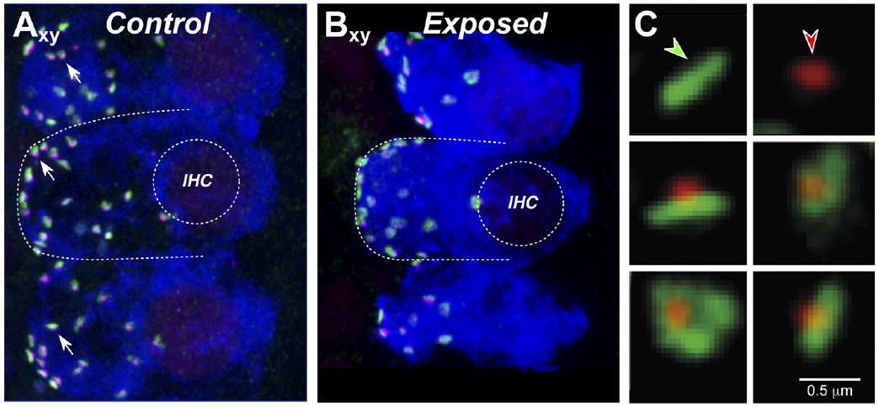
Mechanisms of Auditory Neuropathy
Furman (13)
Noise exposure that causes a Temporary Threshold Shift (or just Age!) → De-afferentiation of the IHC months or years before hair cell death (ABRs, thresholds remain normal)

Slide 8
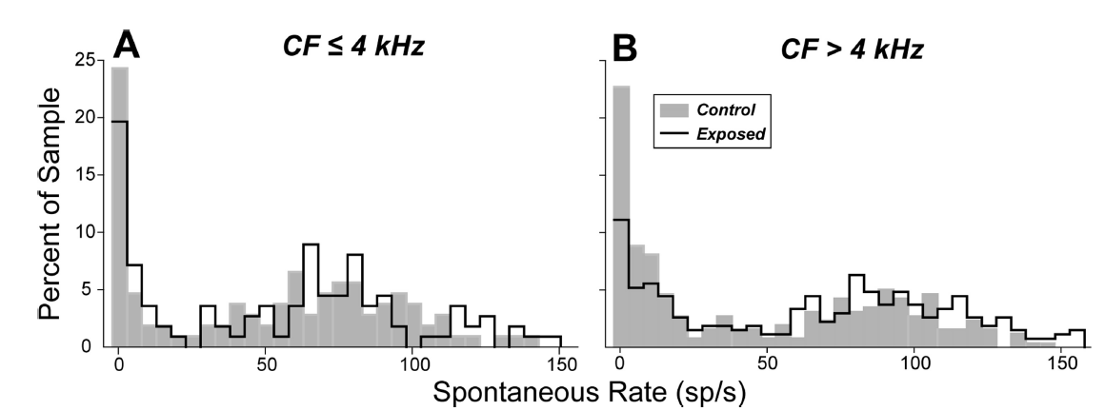
Damage Selects for Low-SR Fibers?
Furman (13)
Low-SR Fibers seem to be particularly vulnerable (Furman, 2013), especially at high frequencies
If so, then this could be a starting place for HHL-like perceptual problems → Low SR fibers preserve our dynamic range at high intensities.

Slide 9
The Big Goal
Given what we observe in animals (mice, gerbil, chinchilla, marmoset), what would a good test to tease out AN degradation look like for humans?
Noninvasive (keeps the IRB happy)
Objective (no subjective/task-reporting bias)
So, ABRs.
Wave I (AN) hard to capture in humans, but lower changes propagate
➔ What AN features are robust?
Design a psychophysical task that will stress low-SR fibers, then correlate ABR changes to it → ABR test.

Slide 10
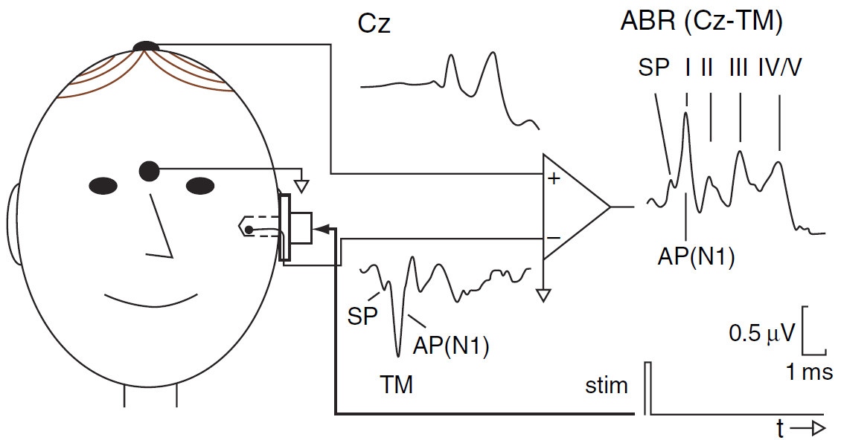
The Auditory Brainstem Response
Durant (08)
Noninvasive, EEG measure of compound neural activity of the auditory periphery to sound
Characteristic wave shapes correlate with proper operation of OHCs, AN, Auditory Brainstem.
Deficiencies in the chain propagate → Diagnostic Use!

Slide 11
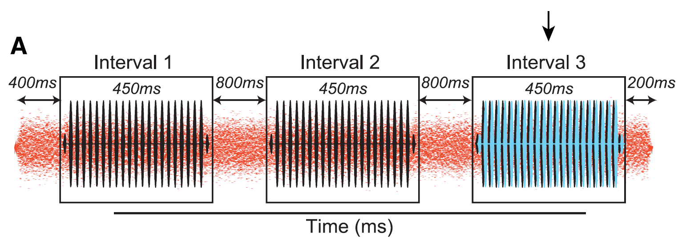
Wave V Latency in Noise (in humans)
Mehraei (16)
Psychophysical Task: Identify a Interaural Time Difference (ITD) shift in the second or third interval of a signal-in-notched-noise presentation ➔ ITD in noise threshold.
Target at 80dB to really recruit low SR fibers
23 subjects with normal (within 15dB) thresholds, “normal” ABRs. (Mehraei et. al, 2016)

Slide 12
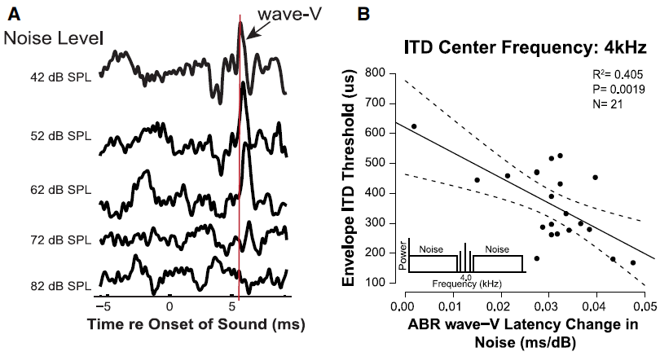
Wave V Latency in Noise (in humans)
Mehraei (16)
Wave V latency changes correlate with performance differences, even in “normal” listeners.
The Idea: Low SR fibers saturate later, are more resistant to noise. If they’re removed, recovery should be slower, and the latency should increase.

Slide 13
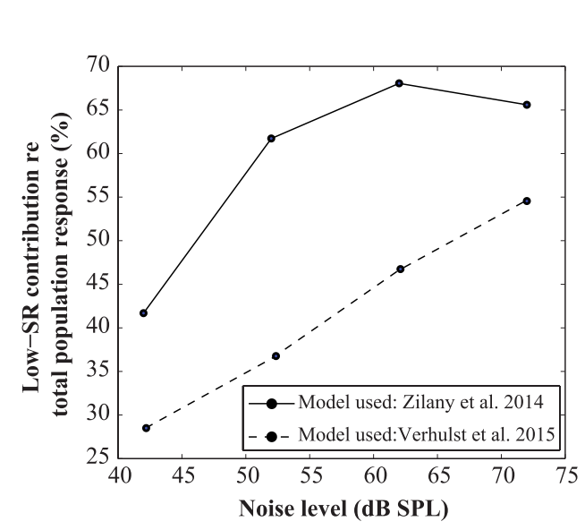
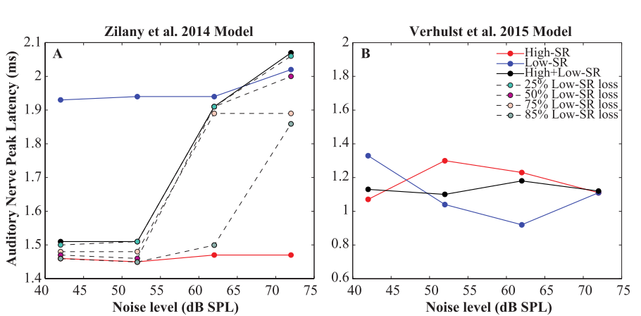
Wave V Latency in Noise (modeled)
Mehraei (15)
Models predict low-SR contribution increase (good)
Zilany and Bruce model shows trend in right direction, but misses the magnitude of the latency change
Verhulst model shows no latency change at all.
➔ The models are not reflecting the data ⬅

Slide 14
Model Deficiencies
At the Auditory Nerve
In the Brainstem
In the Midbrain

Slide 15
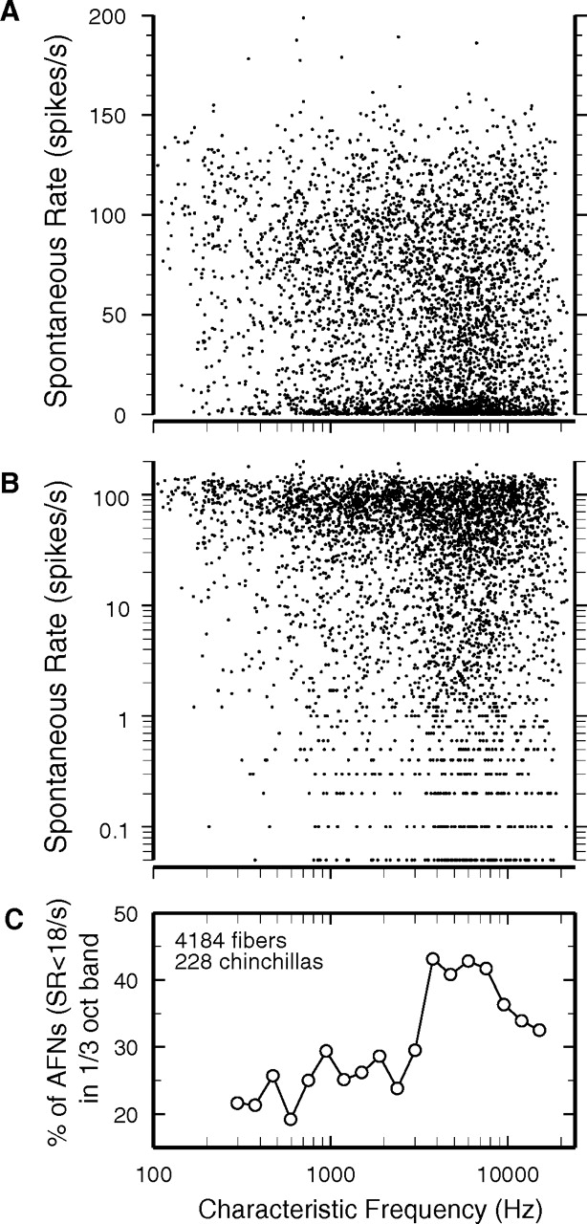
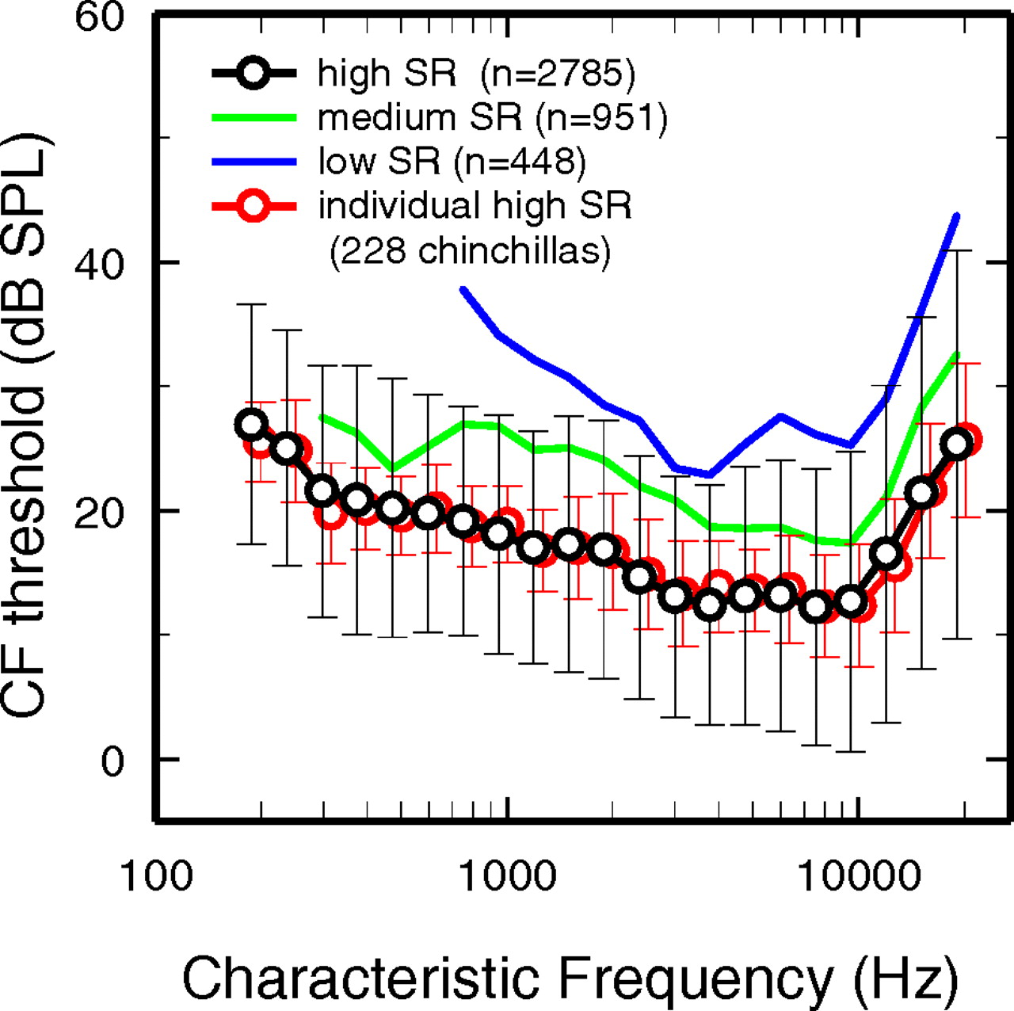
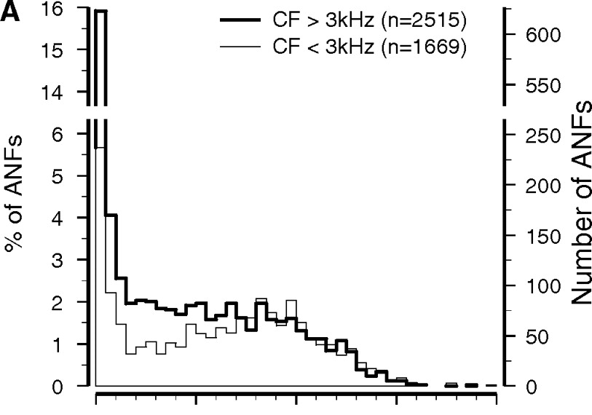
Auditory Nerve: SR Type Might Correlate to CFs
Temchin & Ruggero (2008)

Slide 16
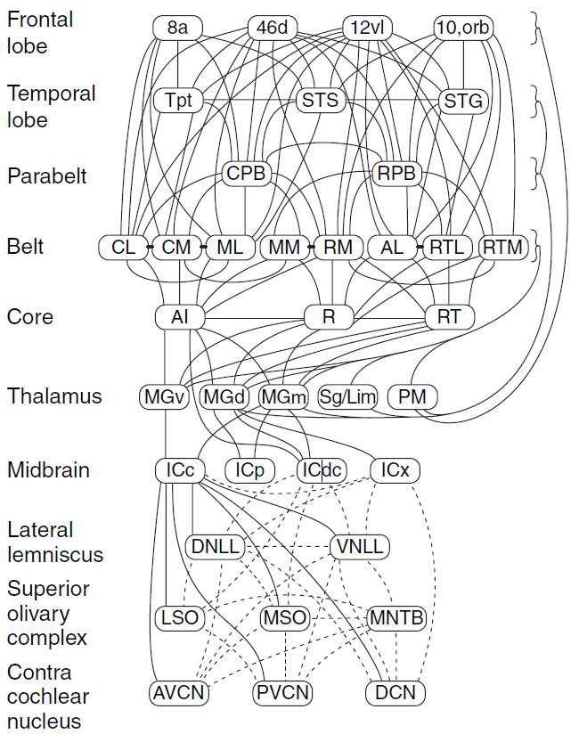
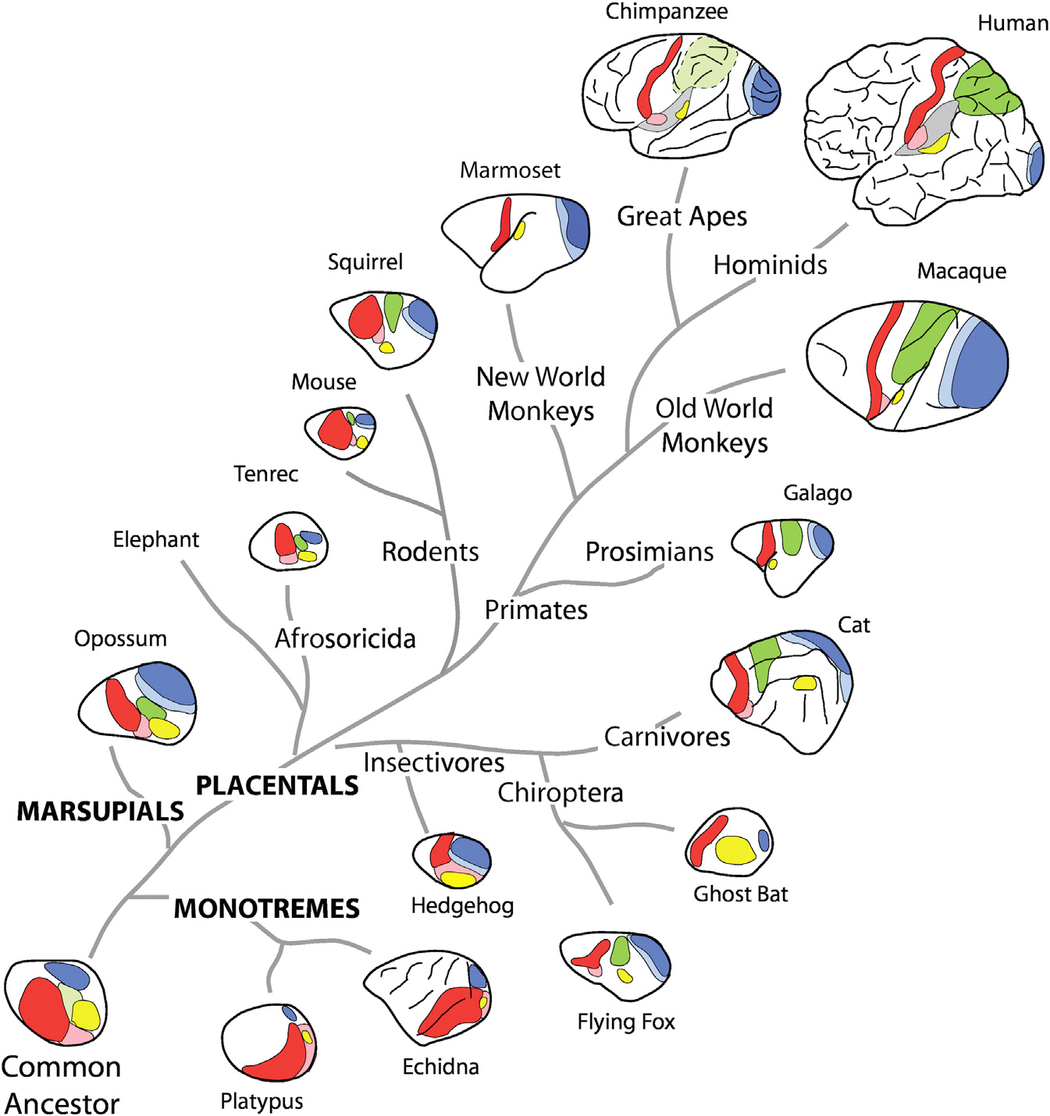
Audition above the AN is Complex
Kaas and Hackett, 2008

Slide 17
Brainstem: Cochlear Nucleus is Complicated
Ruygo (08)
There’s evidence of selective projection of low-SR fibers to the Dorsal Cochlear Nucleus (in cats)
Areas with many low-SR projections bypass the IC (!) but also send collaterals.
Specificity of projection from DCN→IC might correlate with SR.

Slide 18
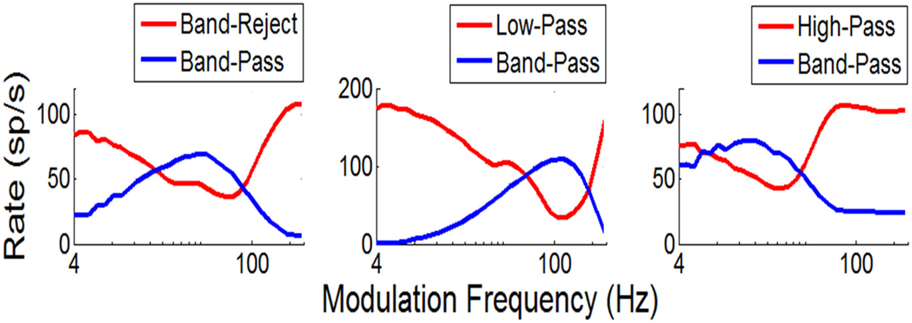
IC: The Midbrain is More Complicated
Carney (15)
IC is very complex
In the Inferior Colliculus, at least 3 neuron types respond to complex tones – not just the 1 modeled so far, with different Modulation Transfer Functions
Assuming selective projection, there’s no guarantee that each MTF “sees” equally weighted SR contributions – and CF dependence effectively guarantees that.

Slide 19
How should the Model(s) be improved?
A good model is a complicated balance between too much and too little.
Not interested in trying to have a model for everything.
A model that plausibly accounts for mechanism and therefore asks questions will work hand-in-hand with experiment.
That sounds great; let’s do that.

Slide 20
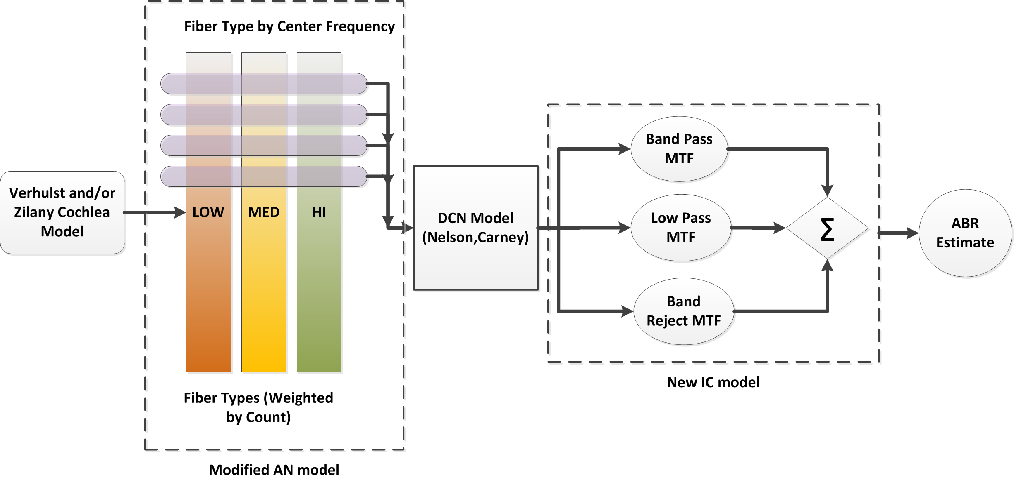
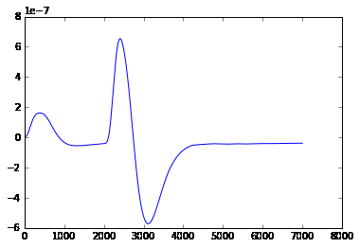
An Improved Model

Slide 21
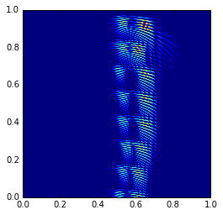
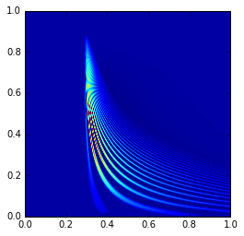
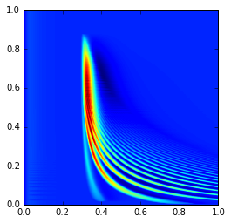
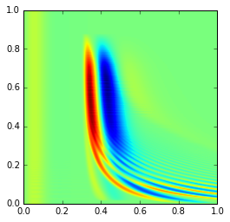
Progress to Date
Models now have a convenient Python framework for fine tuning parameters and stimuli (no matlab!)
Models now run in parallel and are cluster-ready (easy to specify, run, and save many conditions)
Summary statistics are generated on the fly
CF dependence and new IC types in progress right now.

Slide 22
Validate vs. Experimental Data
Use the same stimulus as the human data
Compute Wave V latency shifts
On-line optimization of weights within physiological ranges

Slide 23

Thanks!

